Slide 1
PyVDrive Quickstart
(Cheat Sheet)

Slide 2
Starting PyVDrive
In terminal, enter > vulcan.lava
PyVDrive command UI will be launched (see next page)

Slide 3
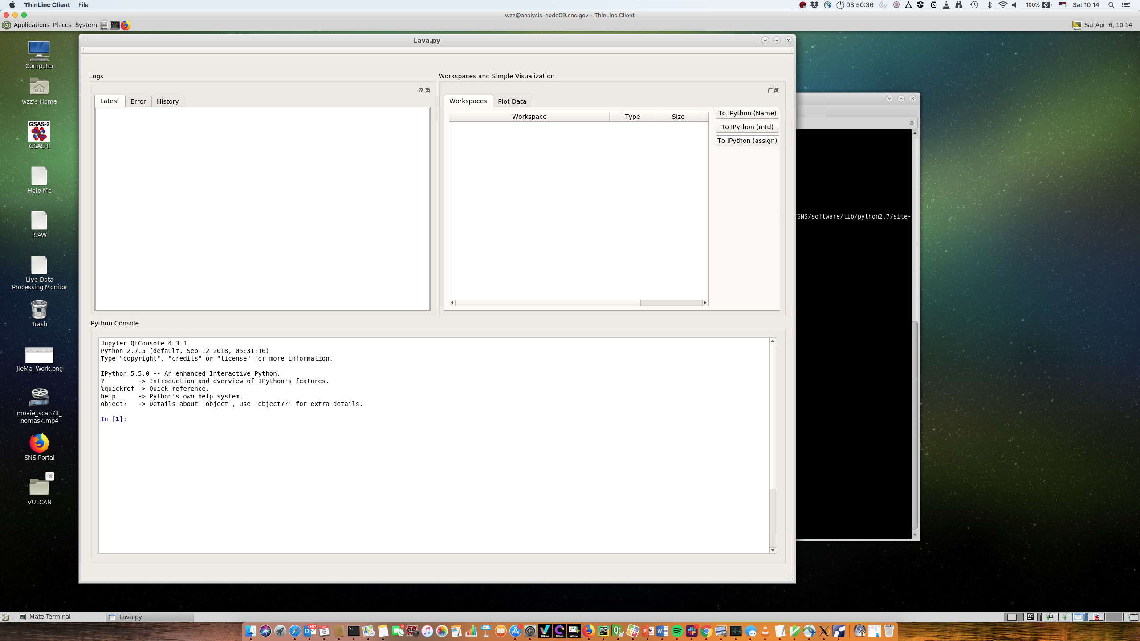
PyVDrive Command UI
IPython Console
1. Support Python
2. Support VDRIVE IDL commands

Slide 4

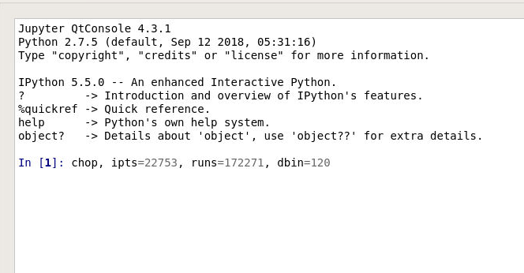
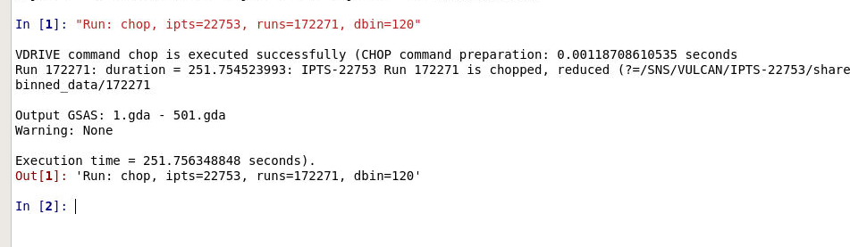

Example: Chop data
Command ”CHOP” > chop, ipts=22753, runs=172271, dbin=120

Slide 5
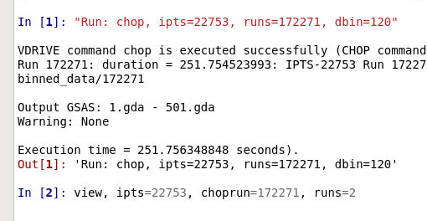
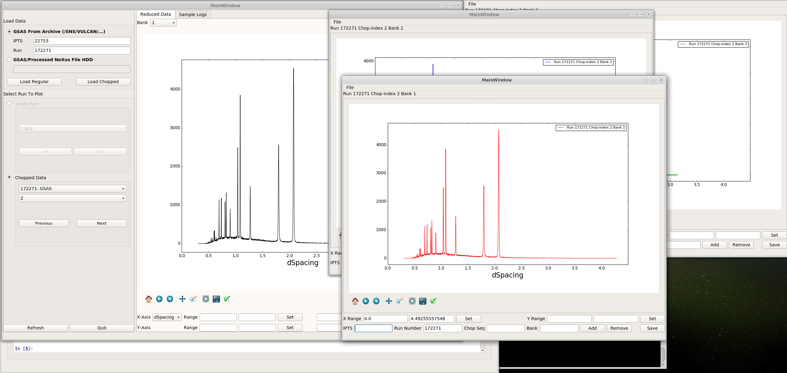
Example: View Chopped Data
View 2nd slice > view, ipts=22753, choprun=172271, runs=2

Slide 6
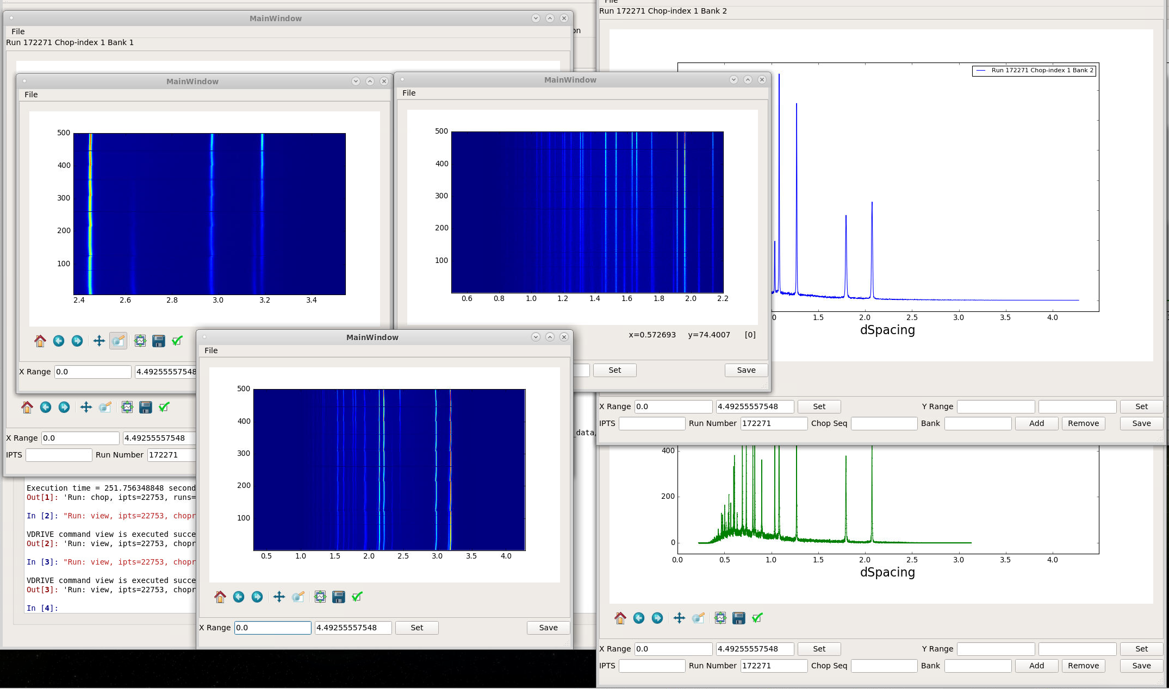
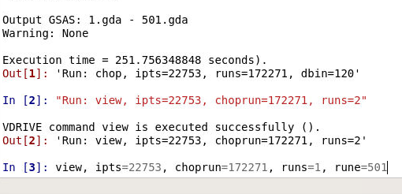
Example: View Chopped Data (2)
View all the sliced and reduced runs > view, ipts=22753, choprun=172271, runs=1, rue=501
3 windows will be popped out for contour view for each bank
3 windows will be popped out for single run diffraction pattern

Slide 7
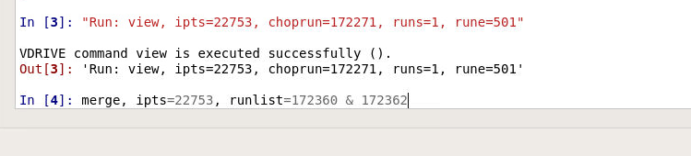
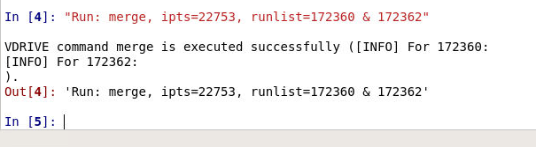
Example: Merge runs
Merge 2 runs together and save the data to first run > merge, ipts=22753, runlist=172360 & 172362

Slide 8
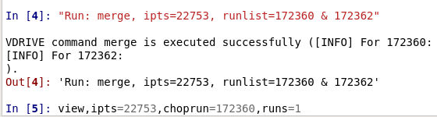
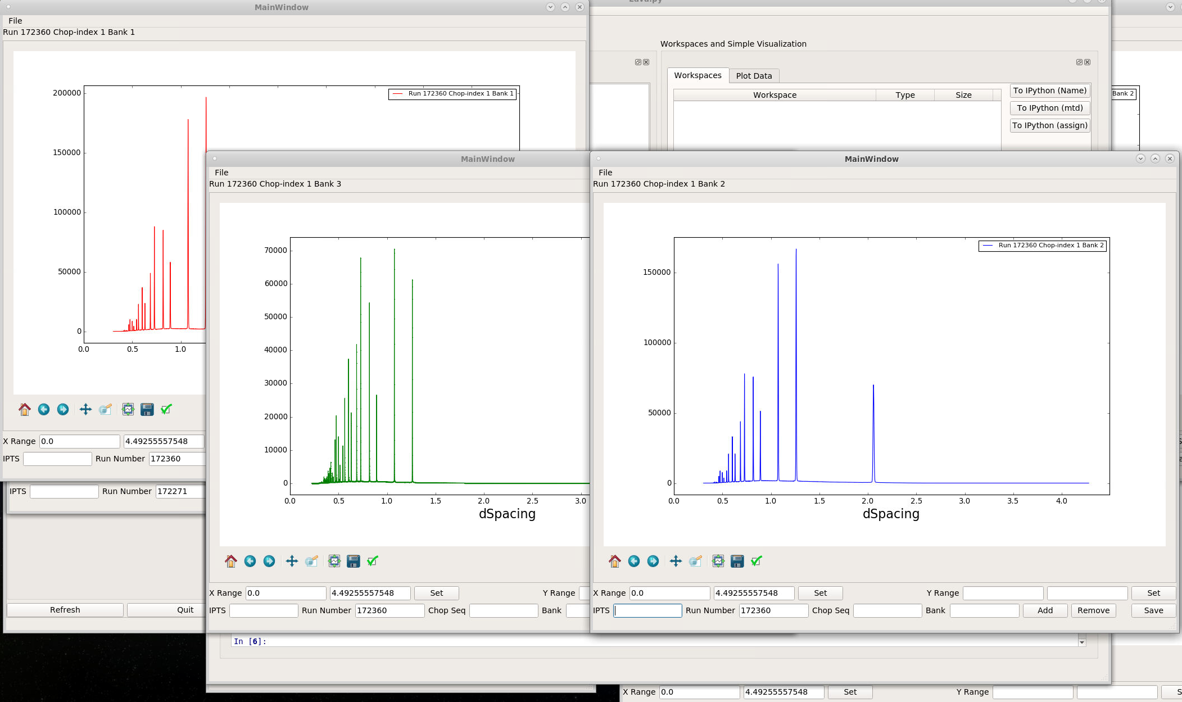
Example: Visualize the merged run
Use VIEW command for chopped run > view, ipts=22753, choprun=172360, runs=1

